Slide 1
Computing Functions Using Turing Machines
Unary Notation for Encoding:
  A method for representing numbers on a tape.
  The number of symbols on the tape represent the number:
    If the tape contains only blanks: 0
    If the tape contains one a: 1
    If the tape contains two a’s: 2
    ...

Slide 2
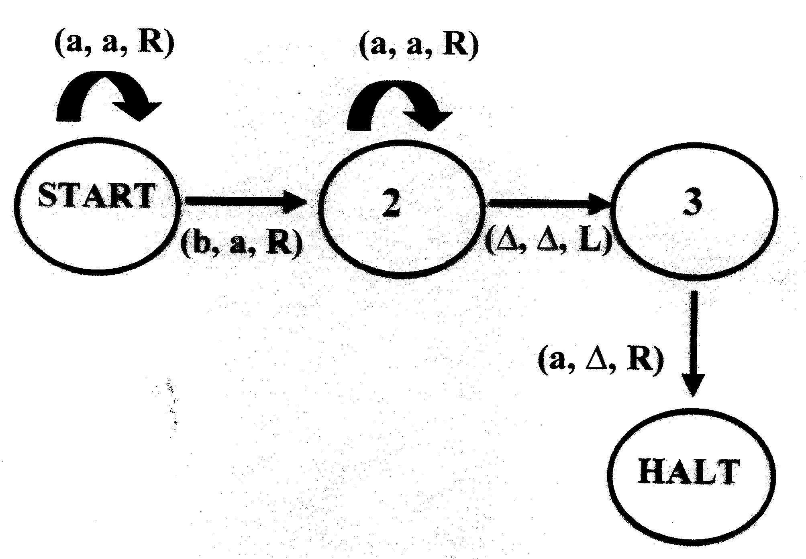
T.M. to compute x+y

Slide 3
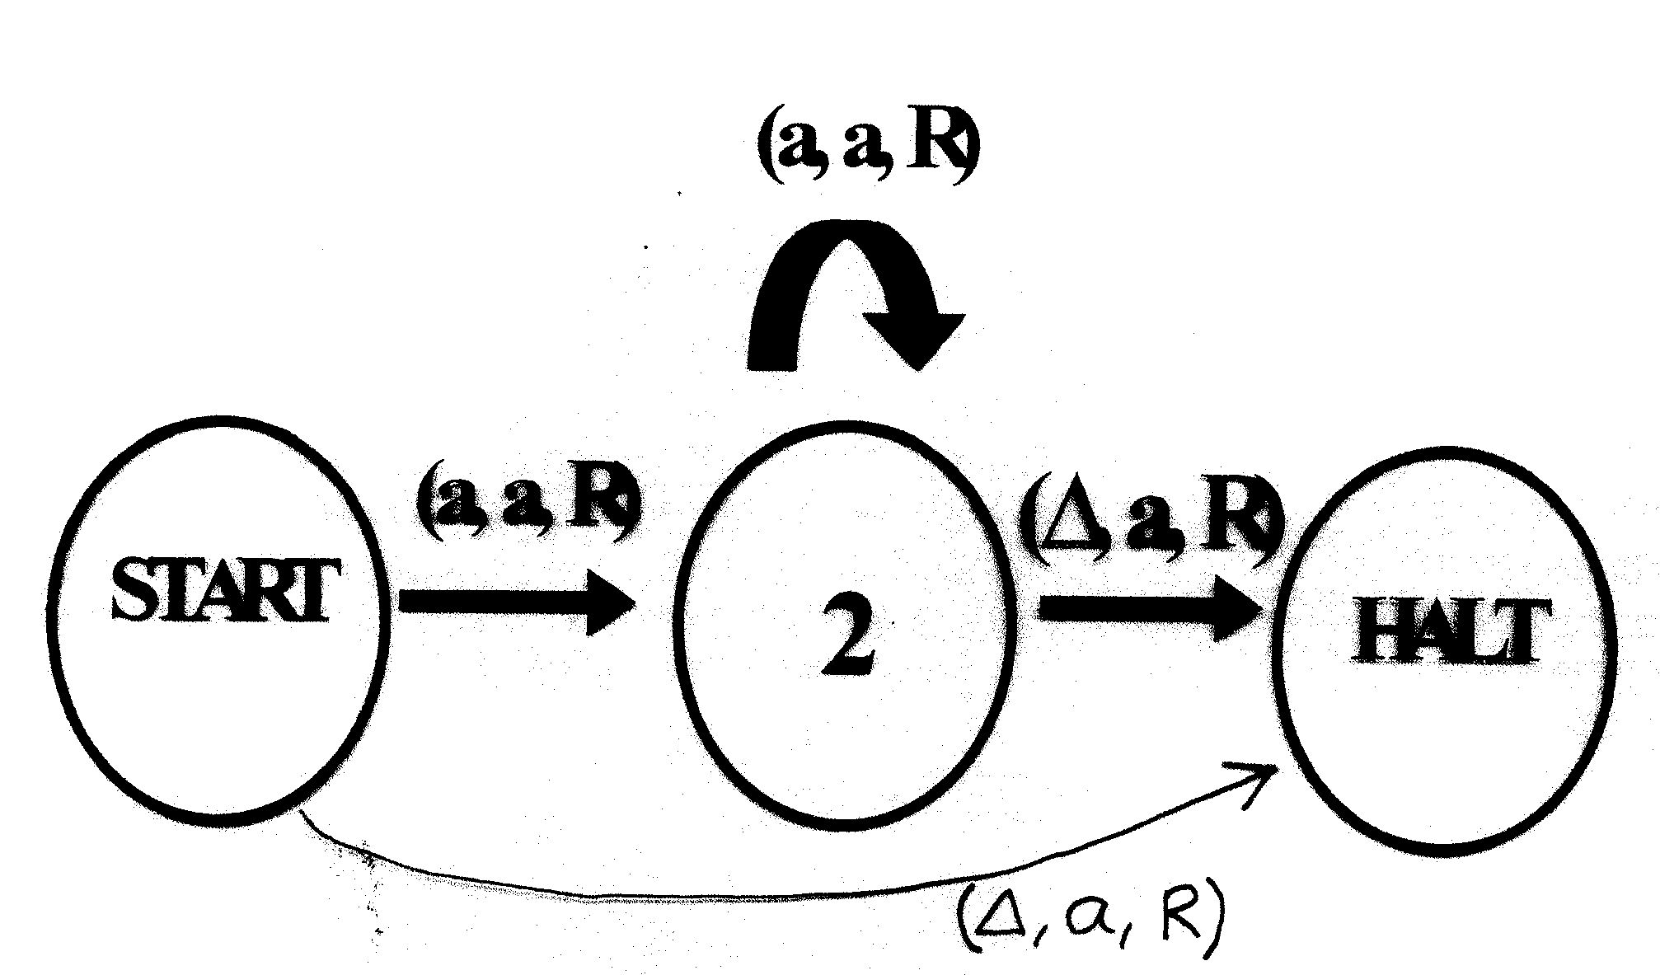
TM to compute F(n)=n+1

Slide 4
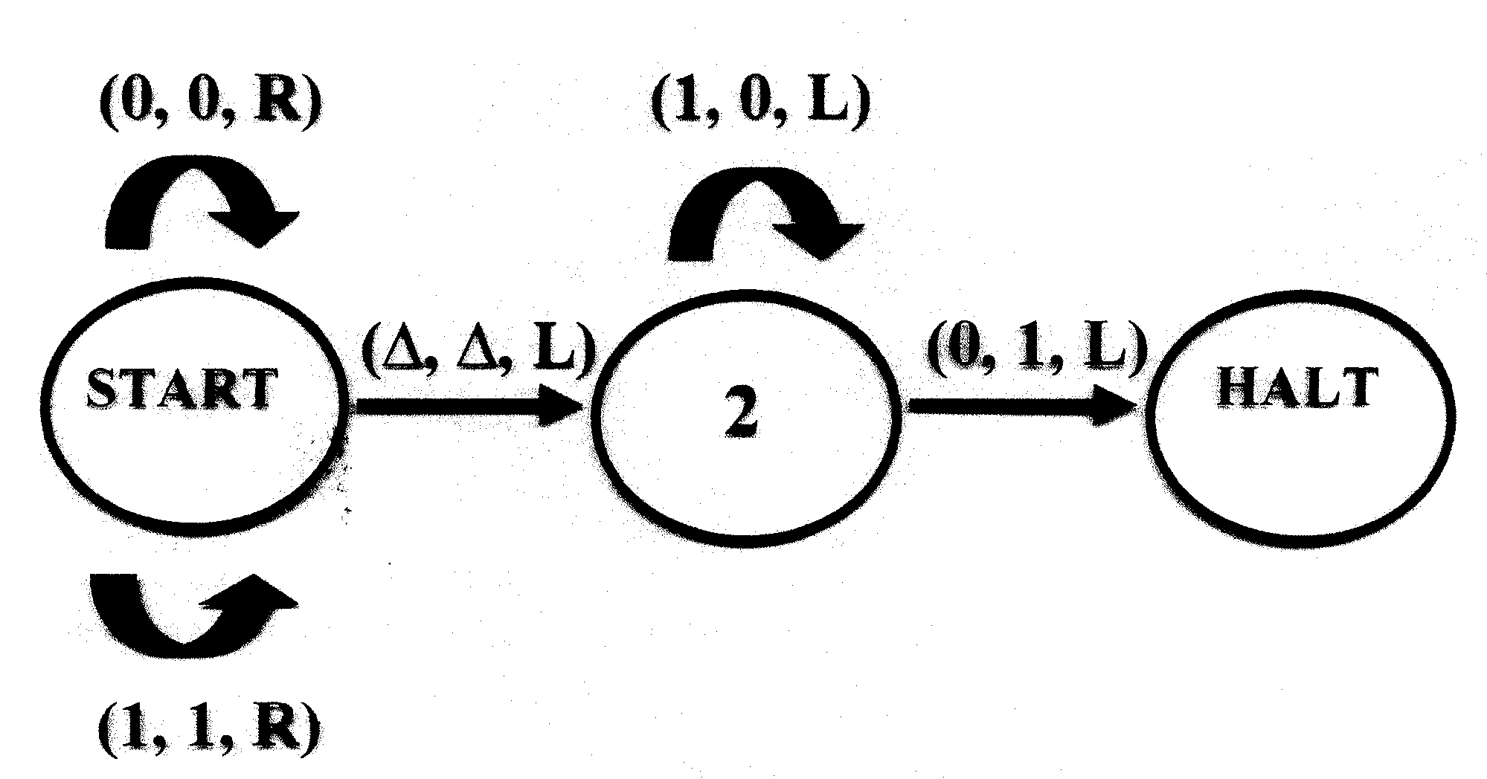
TM to add 1 to a binary number

Slide 5
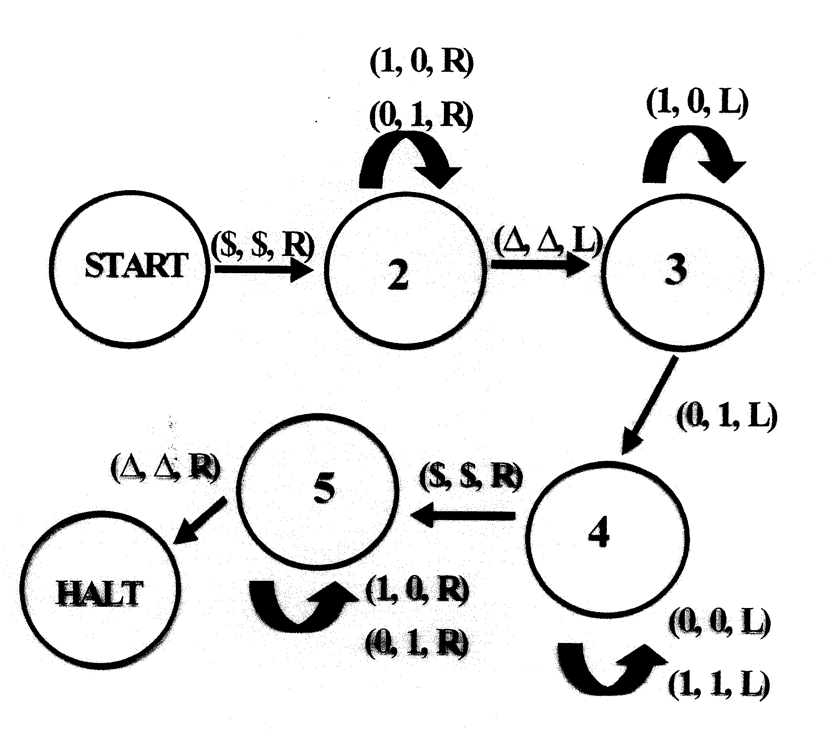
TM for Binary Subtraction

Slide 6
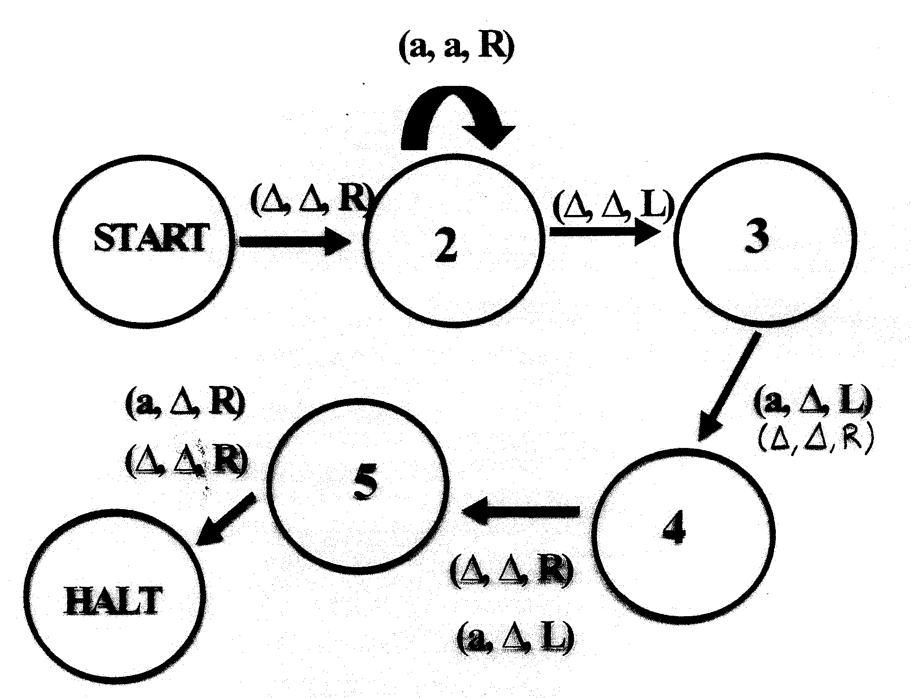
TM for partial function comp:
F(n)=n-3 if n>=3 or
F(n)=0 if 0<=n<3

